Slide 1
CS 419: Production Rendering Glossy Reflection
Eric Shaffer

Slide 2
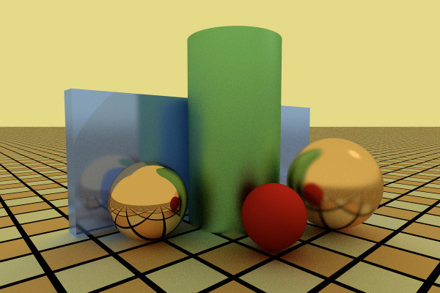
Objectives
Remove inconsistent specular reflection effects
Learn how to model imperfect reflectors
Be able to implement a glossy reflection with varying roughness

Slide 3
Glossy Reflection
Blurry reflection rather than perfect (mirror reflection)
We’ll shoot reflection rays in more than one direction
Be consistent with our specular highlight model
Use the same cosine power formula to generate the ray directions
Density of ray distribution is given by angle around mirror direction
What is e?

Slide 4
Glossy BRDF Model
Our BRDF could be
r is the mirror reflection directio
c is a normalization constant proprtional to e+1
As e → ∞ the BRDF becomes a delta function
Only reflects in the mirror direction

Slide 5
Monte Carlo Estimator
Our approximation of reflected indirect light is now an integral
Because we’re using more than one direction

Slide 6
The pdf
The pdf should be proportional to the BRDF
But we need the cos to go away
So it matches perfect mirror reflection when e → ∞
So then the estimator simplifies to

Slide 7
Generating Reflection Rays
The parameter e controls the blur
Higher e makes the material shinier
What kind reflection happens at e=1 ?
To construct the ray we
need to generate samples on a hemisphere
(s_{x} , s_{y} , s_{z})
map those samples to the hemisphere around r
Construct an orthonormal basis (u,v,w)
w is parallel to r and v,w are in plane normal to r
map origin to p
ray direction is s_{x}u + s_{y}v + s_{z}w

Slide 8
Sampling Issues
Rays can be generated that are below the object surface
Why?

Slide 9

Sampling Issues
Test image e=1, k_{r}=0.8, c_{r}=white, 100 rays per pixel
Color of sphere should be constant
Why?
It’s not
Why?

Slide 10
Fixing the Sampling Issues
Reflect rays below surface through r
Moves them above surface
Biases distribution but it’s still better

Slide 11

Fixing the Sampling Issues
Test for ray below surface
Reflected ray

Slide 12
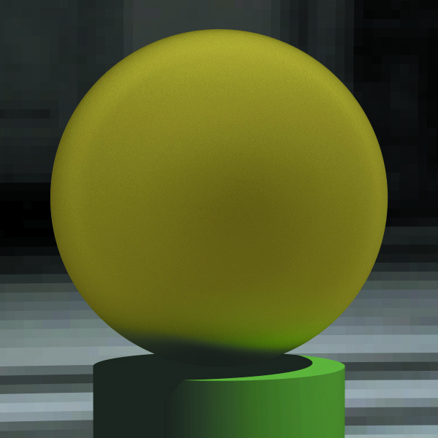
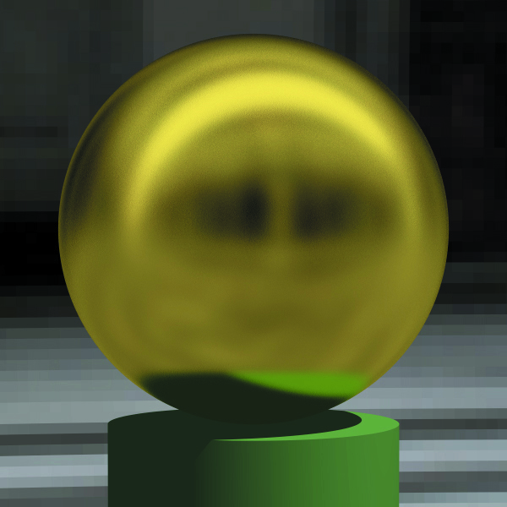
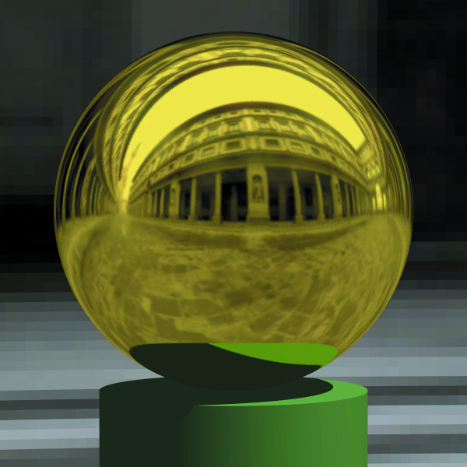
Examples: Varying e

